Slide 1
Why do we need statistics?
Chapter 1

Slide 2
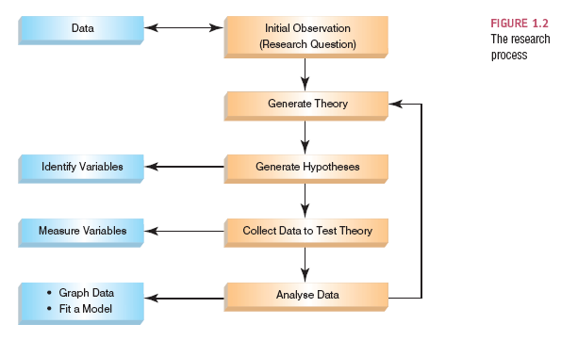
The Research Process
Notes:
Why learn statistics?
Well you are interested in research (or you wouldn’t be here) – so you’ll need data.
Any form of data is going to require a process to understand what the data means, even if it’s just means and graphs.
So we are here to answer interesting questions about data.

Slide 3
Types of Data Analysis
Quantitative Methods
Testing theories using numbers
Qualitative Methods
Testing theories using language
Magazine articles/Interviews
Conversations
Newspapers
Media broadcasts

Slide 4
Initial Observation
Find something that needs explaining
Observe the real world
Read other research
Test the concept: collect data
Collect data to see whether your hunch is correct
To do this you need to define variables
Anything that can be measured and can differ across entities or time.

Slide 5
Example
Find something that needs explaining:
Favorite colors for males versus females
Test the concept: collect data
Please list your favorite color.
Variables
Male versus female
Favorite color

Slide 6
The Research Process

Slide 7
Generating and Testing Theories
Theories
An hypothesized general principle or set of principles that explain known findings about a topic and from which new hypotheses can be generated.
Hypothesis
A prediction from a theory.
E.g. the number of people turning up for a Big Brother audition that have narcissistic personality disorder will be higher than the general level (1%) in the population.
Falsification
The act of disproving a theory or hypothesis.

Slide 8
Example
Theory
Males and females are different, therefore they like different things.
Hypothesis
There will be different favorite colors for males and females
There will be a different number of options for males and females.

Slide 9
The Research Process

Slide 10
Collect Data to Test Your Theory
Independent Variable
The proposed cause
A predictor variable
A manipulated variable (in experiments)
Dependent Variable
The proposed effect
An outcome variable
Measured not manipulated (in experiments)
Notes:
SO we have gender as our IV
DV the most popular option, the number of options.

Slide 11
Example
Independent variable
Gender **
Dependent variable
Most popular option
Number of options

Slide 12
Levels of Measurement
Categorical (entities are divided into distinct categories):
Binary variable: There are only two categories
e.g. dead or alive.
Nominal variable: There are more than two categories
e.g. whether someone is an omnivore, vegetarian, vegan, or fruitarian.
Ordinal variable: The same as a nominal variable but the categories have a logical order
e.g. whether people got a fail, a pass, a merit or a distinction in their exam.

Slide 13
Levels of Measurement
Continuous (entities get a distinct score):
Interval variable: Equal intervals on the variable represent equal differences in the property being measured
e.g. the difference between 6 and 8 is equivalent to the difference between 13 and 15.
Ratio variable: The same as an interval variable, but the ratios of scores on the scale must also make sense
e.g. a score of 16 on an anxiety scale means that the person is, in reality, twice as anxious as someone scoring 8.
Notes:
True zero points

Slide 14
Example
IV = Gender = Binary categorical variable
Many research designs require categorical IVs (like ANOVA)
Levels
DV
Most popular option = Nominal categorical variable
Range of options = Ratio scale

Slide 15
Measurement Error
Measurement error
The discrepancy between the actual value we’re trying to measure, and the number we use to represent that value.
Example:
You (in reality) weigh 80 kg.
You stand on your bathroom scales and they say 83 kg.
The measurement error is 3 kg.

Slide 16
Example
What might be measurement error for our favorite color example?

Slide 17
Validity
Whether an instrument measures what it set out to measure.
Content validity
Evidence that the content of a test corresponds to the content of the construct it was designed to cover
Ecological validity
Evidence that the results of a study, experiment or test can be applied, and allow inferences, to real-world conditions.
Notes:
So our study would have both because it measures what we expected it to measure (fav color) and that’s ecologically valid because we could apply it to real world situations (clothes buying).

Slide 18
Reliability
Reliability
The ability of the measure to produce the same results under the same conditions.
Test-Retest Reliability
The ability of a measure to produce consistent results when the same entities are tested at two different points in time.

Slide 19
How to Measure
Correlational research:
Observing what naturally goes on in the world without directly interfering with it.
Experimental research:
One or more variable is systematically manipulated to see their effect (alone or in combination) on an outcome variable.
Statements can be made about cause and effect.

Slide 20
Example
Therefore, our study is somewhere between correlational and experimental.
We didn’t really manipulate anything …
But we are using different groups …
Often called quasi-experimental design.

Slide 21
How to Measure
Cross-sectional research:
This term implies that data come from people at different age points with different people representing each age point.
Longitudinal research:
Data come from the same people over different time points in their lives.

Slide 22
Experimental Research Methods
Cause and Effect (Hume, 1748)
Cause and effect must occur close together in time (contiguity);
The cause must occur before an effect does;
The effect should never occur without the presence of the cause.

Slide 23
Experimental Research Methods
Confounding variables: the ‘Tertium Quid’
A variable (that we may or may not have measured) other than the predictor variables that potentially affects an outcome variable.
Ruling out confounds (Mill, 1865)
An effect should be present when the cause is present and that when the cause is absent the effect should be absent also.
Control conditions: the cause is absent.

Slide 24
Example
What are some potential confound variables for our color study?

Slide 25
Methods of Data Collection
Between-group/Between-subject/independent
Different entities in experimental conditions

Slide 26
Methods of Data Collection
Repeated measures (within-subject)
The same entities take part in all experimental conditions.
Economical
Practice effects
Fatigue

Slide 27
Example
Our study is between-subjects because each person is only in one group (level).

Slide 28
Types of Variation
Systematic Variation (treatment)
Differences in performance created by a specific experimental manipulation.
Unsystematic Variation (error)
Differences in performance created by unknown factors.
Age, Gender, IQ, Time of day, Measurement error etc.

Slide 29
Types of Variation
So what do you to do control for variation?
Randomization
Minimizes unsystematic variation.
In a BN design – randomize to groups
In a RM design – randomize order of levels
Counterbalancing

Slide 30
The Research Process

Slide 31
Analysing Data: Histograms
Frequency Distributions (aka Histograms)
A graph plotting values of observations on the horizontal axis, with a bar showing how many times each value occurred in the data set.
The ‘Normal’ Distribution
Bell shaped
Symmetrical around the centre

Slide 32
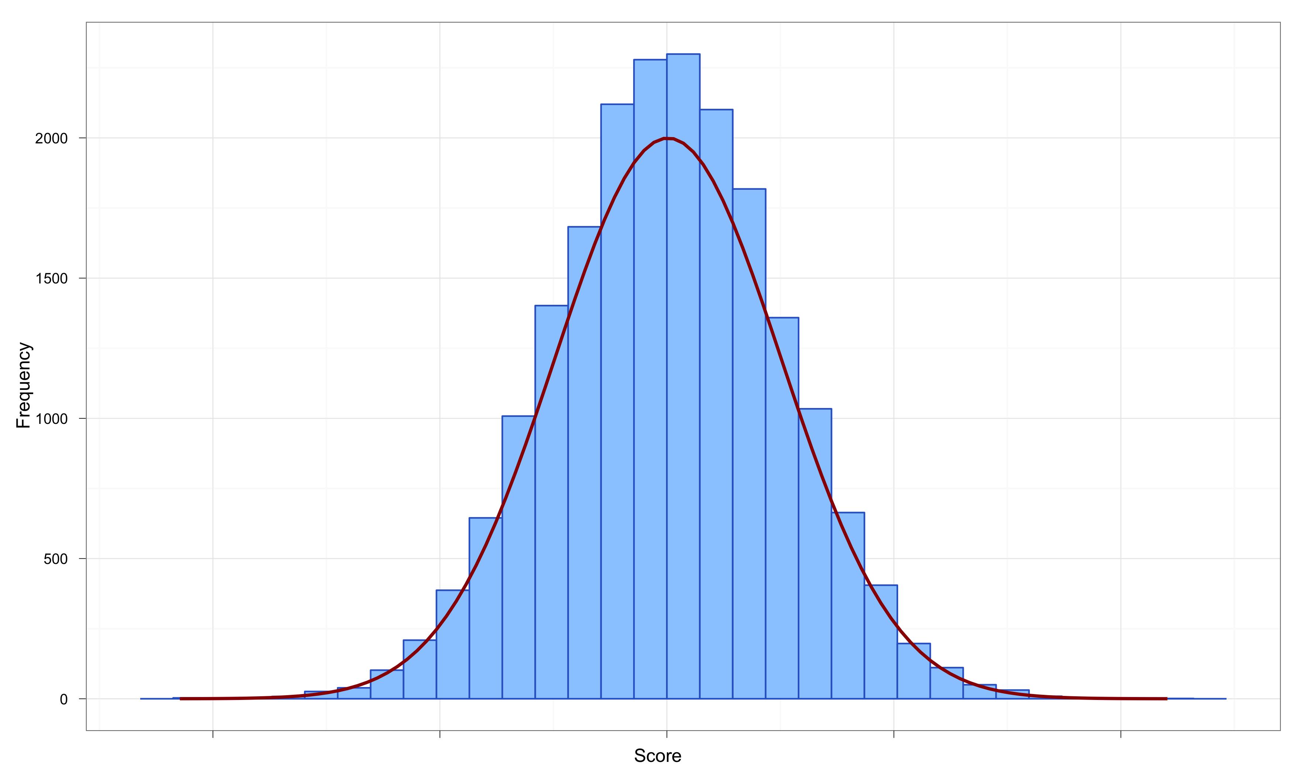
The Normal Distribution
The curve shows the idealized shape.

Slide 33
Properties of Frequency Distributions
Skew
The symmetry of the distribution.
Positive skew (scores bunched at low values with the tail pointing to high values).
Negative skew (scores bunched at high values with the tail pointing to low values).

Slide 34
Skew

Slide 35
Properties of Frequency Distributions
Kurtosis
The ‘heaviness’ of the tails.
Leptokurtic = heavy tails.
Platykurtic = light tails.

Slide 36
Kurtosis

Slide 37
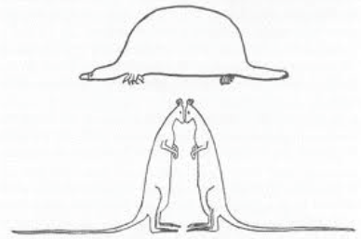
Kurtosis

Slide 38
Central tendency: The Mode
Mode
The most frequent score
Bimodal
Having two modes
Multimodal
Having several modes

Slide 39
Bimodal and Multimodal Distributions

Slide 40
Central Tendency: The Median
The Median is the middle score when scores are ordered:

Slide 41
Central Tendency: The Mean
Mean
The sum of scores divided by the number of scores.
Number of friends of 11 Facebook users.

Slide 42
The Dispersion: Range
The Range
The smallest score subtracted from the largest
For our Facebook friends data the highest score is 234 and the lowest is 22; therefore the range is: 234 −22 = 212

Slide 43
Deviance
We can calculate the spread of scores by looking at how different each score is from the center of a distribution e.g. the mean:

Slide 44
Example
Deviance from the average number of responses for each group
I know this is two numbers but take my word for it mathematically it’s the same for lots of them.

Slide 45
Sum of Squared Errors, SS
Indicates the total dispersion, or total deviance of scores from the mean:
It’s size is dependent on the number of scores in the data.
More useful to work with the average dispersion, known as the variance:

Slide 46
Standard Deviation
The variance gives us a measure in units squared.
This problem is solved by taking the square root of the variance, which is known as the standard deviation:

Slide 47
Same Mean, Different SD

Slide 48
Important Things to Remember
The Sum of Squares, Variance, and Standard Deviation represent the same thing:
The ‘Fit’ of the mean to the data
The variability in the data
How well the mean represents the observed data
Error

Slide 49
The Normal Probability Distribution

Slide 50
Going beyond the data: Z-scores
Z-scores
Standardising a score with respect to the other scores in the group.
Expresses a score in terms of how many standard deviations it is away from the mean.
The distribution of z-scores has a mean of 0 and SD = 1.

Slide 51
Properties of z-scores
Mean = 0
This number is incredibly useful, like for serious.
Standard deviation = 1

Slide 52
Properties of z-scores
1.96 cuts off the top 2.5% of the distribution.
−1.96 cuts off the bottom 2.5% of the distribution.
As such, 95% of z-scores lie between −1.96 and 1.96.
99% of z-scores lie between −2.58 and 2.58,
99.9% of them lie between −3.29 and 3.29.

Slide 53
Probability Density function of a Normal Distribution

Slide 54
Reporting Data
Dissemination of Research
Findings are presented at conferences and in articles published in scientific journals.
Knowing how to report data
Chose a mode of presentation that optimizes the understanding of the data;
If you present three or fewer numbers then try using a sentence;
If you need to present between 4 and 20 numbers consider a table;
If you need to present more than 20 numbers then a graph is often more useful than a table.

Slide 55
STOP! SPSS Time!
Enter data
Frequency Table
Histogram
Central tendency (mean, mode, median)
Deviance (variance, standard deviation)
Z-scores

